Slide 1
JS Forms
Module 10

Slide 2
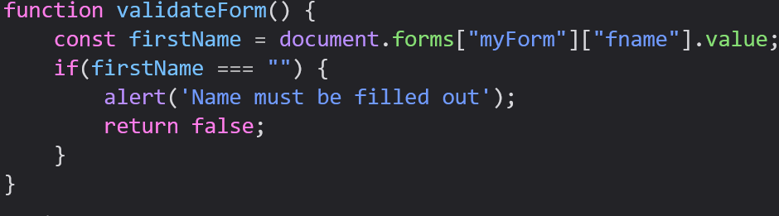
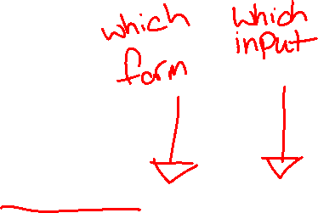
Forms
JavaScript is useful for validating form information
When we submit a form, we can give the button an event handler that validates our inputs

Slide 3
Automatic HTML Form Validation
Your browser can perform limited automatic validation for you
The required attribute of an HTML element will prevent a form from being submitted without entering a value
Note: Older versions of Internet Explorer do not support this

Slide 4
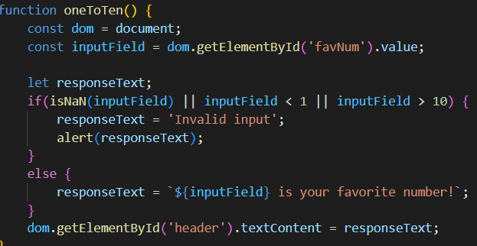
Input Validation
We generally don’t process forms on the front end, but it is our job to be sure that the input is in the correct format
We can write JavaScript code on our forms that the data we collect is usable

Slide 5
Data Validation
Some of the common data validation tasks we perform are:
Checking that the user has entered all required fields
Checking that the user has entered a valid date
Checking that the user has entered the right type of input in a field

Slide 6
Data Validation
Data validation can be done on the server side as well, but that is generally reserved for either sensitive information or for more complex checks
Clients may not have the resources to perform the complicated validation data may need
Malicious users may try to bypass validation to inject data to a server

Slide 7
HTML Constraint Validation
Constraint Validation is client side validation performed by HTML that doesn’t need any JavaScript to operate
The required attribute was one form of constraint validation, but there are many others
Constraint validation is based on HTML Input Attributes and CSS Pseudo Selectors

Slide 8
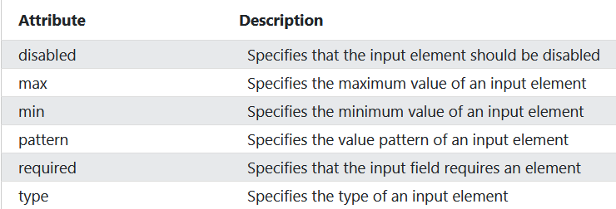
HTML Input Attributes

Slide 9
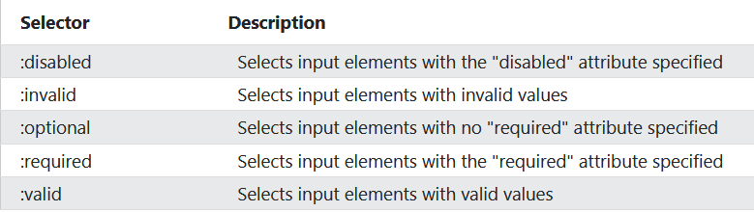
CSS Pseudo Selectors

Slide 10
Forms API

Slide 11
Constraint Validation DOM Methods
checkValidity(): Returns true if an input element contains valid data
setCustomValidity(): Sets the validationMessage property of an input element

Slide 12
Constraint Validation DOM Properties
validity: An object containing boolean properties related to the validity of an input element
validationMessage: Contains the message a browser will display when the validity is false
willValidate: Indicates if an input element will be validated

Slide 13
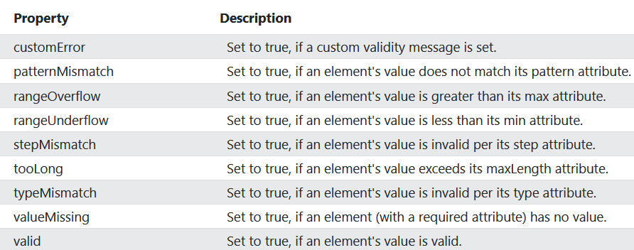

Validity Properties

Slide 14
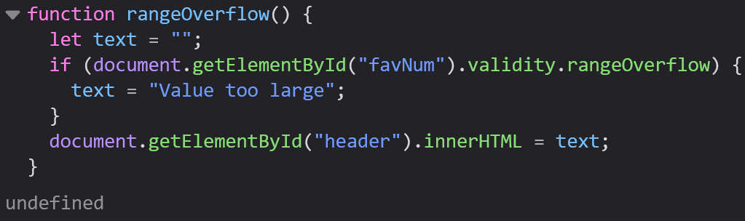
Example: rangeOverflow Property

Slide 15
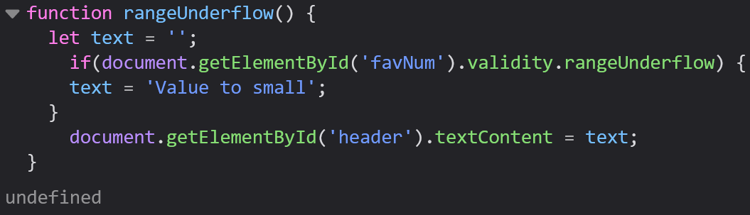
Example: rangeUnderflow Property

Slide 16
For Today:
Module 10 Exercises
Atometric
Previous Exercises

